Slide 1
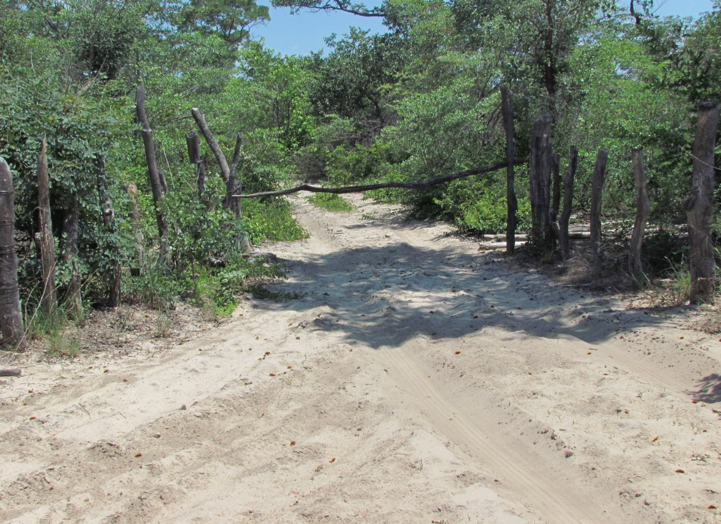
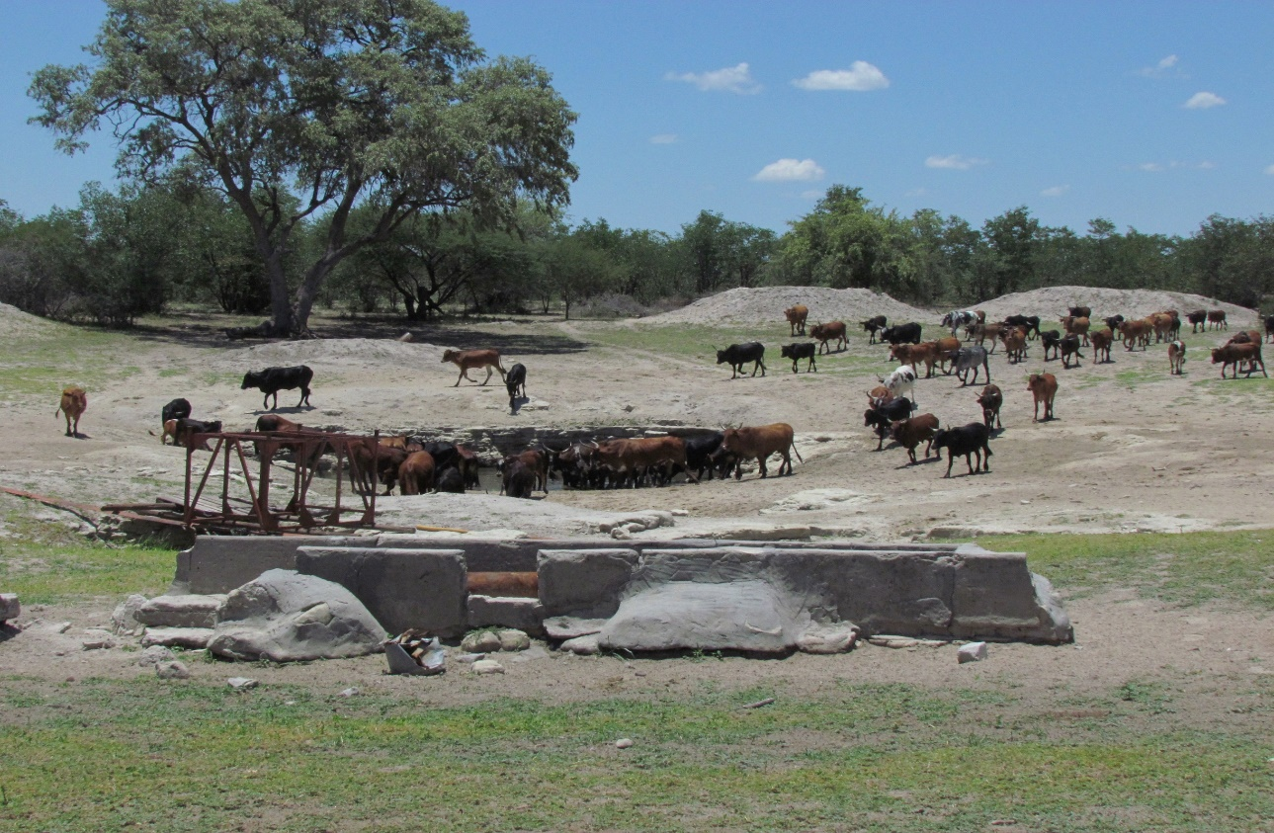
Land tenure and governance on communal land in Namibia Presentation for 2nd National Land Conference, 1-5 October 2018
Wolfgang Werner
Department of Land and Property Sciences
NUST

Slide 2
Aim
Department of Land and Property Sciences
Explain tenure and governance
Identify a few issues for dicussion

Slide 3
What is land tenure and governance?
Department of Land and Property Sciences
Land tenure:
A right to hold land (conditions, duration, access…)
Typically a bundle of rights and duties that different levels of society (individuals, households, family etc.) enjoy regarding natural resources)
Governance
Governance is concerned with the processes by which citizens participate in decision‐making
It is the way in which society is managed and how the competing priorities and interests of different groups are reconciled
It includes the formal institutions of government but also informal arrangements
Governance, how government is accountable to its citizens, and how society obliges its members to observe its rules and laws

Slide 4
Tenure and governance framework: the CLRA, 2002
Department of Land and Property Sciences
Tenure arrangements and governance frameworks were in disarray in 1990
Policy development process started with the 1st Land Conference in 1991
Culminated in the CLRA, 2002
Provisions on tenure:
Make customary tenure more secure registration process
Tenure reform : leaseholds
Provisions on governance:
Central role of TAs
Communal Land Boards
Dispute resolution and appeals procedures

Slide 5
Governance: traditional leaders
Department of Land and Property Sciences
TAs continue to play a central role in administering land rights
Their powers and mandates were ill-defined and contested in many areas up to 2002
CLBs introduced to improve transparency and accountability by defining roles and functions more adequately
Problems remain

Slide 6
Definition of TAs in CLRA
Department of Land and Property Sciences
CLRA refers to recognised Chiefs and Traditional Authorities
Unrecognised TAs cannot perform any functions under the CLRA such as validating and approving customary land rights
Leads to difficulties in registering customary land rights
Some recognised TAs do not have defined areas of jurisdiction
Different TAs allocating or verifying land rights in the same geographic area
No recognition of tiered nature of TAs
Each tier has different responsibilities and functions
Village headmen are a central land manageent institution in this hierarchy
Notes:
Definition is important because currently the CLRA canot be implemented in some parts of the country due, for example to unrecognised TAS

Slide 7
No guidelines for local level land governance
Department of Land and Property Sciences
But no guidelines to headmen on the allocation and cancellation of land rights or procedures for dispute resolution
Functions of land allocation, cancellation and dispute resolution not separated
TAs are often the cause of disputes
Appeals against decisions of TAs provided for in the Act
Need to be in writing and directed to PS
Excludes many people who may not be sufficiently proficient in the fficial language or
Appeals procedure may also not be easily accessible due to remoteness of many rural households

Slide 8
Customary practices vs statutory requirements
Department of Land and Property Sciences
CLRA does not interfere in customary practices of land administration at village level
TAs have to implement customary and statutory provisions
Impacts negatively on land rights of women
CLRA provides for equal rights of women to access land in their own right
Customary practices often undermine this equality
Widows should no longer be evicted after husbands death
But in term of matrilineal inheritance practices they often lose moveable property

Slide 9
Governance at higher level
Department of Land and Property Sciences
CLRA improves accountability: CLB
To oversee whether customary land right allocations and cancellation are within the law
TAs account upwards – to CLB
No legal obligation to account and consult downwards about major land rights decisions
Makes customary land rights holders vulnerable to large-scale projects and privatisation of communal land

Slide 10
Improving tenure security
Department of Land and Property Sciences
CLRA facilitated increased security of customary land rights to some extent – mapping and registration
Problem: limited to private rights (homesteads, fields and stock pens)
Size limit 20ha for new customary land rights – size limit not applicable to exisiting land rights
Impact limited to crop growing areas
In non-crop growing semi-arid parts of the country the 20ha limit resulted in insecurity and uncertainty
Commonage not covered – groups of people have no legal protection to areas used communally
A draft policy on group rights has been in existence since 2005

Slide 11
Local level management
Department of Land and Property Sciences
PCLD encourages establishment of legal entitites (co-operatives) to protect group rights in project areas through leasehold
Co-operatives provide an institutional framework for local level management
New land policy should provide for this without the necessity to establish legal entities
CLRA does not provide for it but other legislation (conservancies, community forests and water user associations)
Different laws not always complementary
Need to harmonise them

Slide 12
Privatisation of communal land
Department of Land and Property Sciences
Since the 1970s large tracts of communal grazing land have been fenced for private use
Commonly referred to as ‘illegal fencing’
This description only fits fencing that occurred after 2002 neatly
Before 2002: legal and policy framework too ambiguous to judge a fence to be legal or illegal
Official privatisation implemented through PCLD (c. 62 land parcels surveyed)
Unofficial fencing should be regularised
Requires an adjudication process
Notes:
Adjudication is the legal process by which an arbiter or judge reviews evidence and argumentation, including legal reasoning set forth by opposing parties or litigants to come to a decision which determines rights and obligations between the parties involved.

Slide 13
‘Bankability’ and land markets
Department of Land and Property Sciences
‘Bankability’ widely shared demand – also in the small-scale farming resettlement sector
Leaseholds and customary land rights cannot be traded
Negates the collateral value of land – without a market there is no collateral
Asset poor farmers
Informal land markets are growing
Little empirical data on nature and extent
Land markets for small scale farmers both in communal areas and on resettlement land should be encouraged
Needs careful regulation

Slide 14
Concluding remarks
Department of Land and Property Sciences
Evidence-based policy development is needed
Must inlculde an independent review of what worked and what did not
Many issues need much more empirical information / data which we do not have
Subject matter specialist reports needed
My recommendation:
that this Conference be regarded as the beginning of a longer policy development process; and
that participants take a decision to request higher authorities to provide the space after the Conference to explore issues in more depth
that such a process is well-planned and adequately resourced

Slide 15
Thank you

