Slide 1
Flexible Land Tenure System
Upgradable Land Tenure System Under the Flexible Land Tenure System
Presentation to the 2nd National Land Conference Participants
By: Gabriel Iindombo
Deputy Director, Land Boards Tenure & Advice Ministry of Land Reform

Slide 2
Presentation Outline
Introduction
Objectives of FLTS
Benefits of FLTS
Pilot Local Authorities
Key Stakeholders involved in FLTS
Process Flow on Establishing a FLTS Scheme
Types of Land Rights under the FLTS
Conclusion

Slide 3
Introduction
Flexible Land Tenure System, is a Scheme established under the Flexible Land Tenure Act (Act No. 4 of 2012)
Aiming at providing affordable security of tenure to informal settlement settlers
The FLTS is targeting people who live in the informal settlement/low income people
Provision of a parallel tenure registration system
FLTS Scheme can only be established on land within the local authority (Municipalities, Towns, Settlements, Village Councils)
MLR overseeing the implementation of FLTS Scheme
Other stakeholders are MURD, Local Authorities, Land Rights Office, GIZ & Beneficiaries
Beneficiaries Association

Slide 4
The Objectives of the FLTS
to creates alternative new forms of titles i.e. Starter Titles and Land Hold Titles, that can be upgraded to Freehold Titles
to provide security of title for persons who live in the informal settlements or who are provided with low income housing
to empower the persons concerned economically by means of these rights.

Slide 5
Benefits of FLTS
Provide security of title for persons who live in the informal settlements in perpetuity (offers titles to immovable properties)
Titles are cheaper to register (GRN pay for surveying & registration costs)
Provide legal documentary proof of land ownership
Beneficiaries will invest in their land without fear of being evicted
Titles can allow erection of dwelling on a blockerf
Titles are transferrable from one person to other
Titles are inheritable (lease the property)
Titles may be used as collateral (land hold title)
Titles can be upgraded till freehold
Reduction of boundary disputes due to internal measurement (land hold plan)

Slide 6
FLTS Piloting Areas
City of Windhoek
Onyika,
Havana,
Freedomland A & B
Oshakati Town Council
Onawa area
Municipality of Gobabis
Freedom Square

Slide 7
Key Stakeholders
GIZ
MLR
MURD
Appoints Members
Steering Committee
Nominates Senior Management for SC
Appoints
Officers
Dept. of
Land Management
Dept. of Land Reform, Resettlement and Regional Programme Implementation
Close cooperation
Directorate
of Survey and
Mapping
Directorate
of
Deeds
Directorate
of Land Reform
and
Resettlement
Nominates Senior Management for SC
Support and Guidance
To be established: FLTS Project Management Unit (PMU)
Support and
Guidance
Support and
Guidance
Support and
Guidance
Sec. 6 FLTA Directives and
Inspections
To be established: Land Rights Office(s)
Relevant Authorities
Close
Cooperation
Close
Cooperation
Close
Cooperation
To be established: Associations (Communities)
Informal settlements (Communities)

Slide 8

Process of Establishing FLTS Scheme
Application to establish a Scheme
Owner of the piece of land
Local Authority (LA)
Group of people who reside on the piece of land
Request to MLR
If Feasilbilty study fails, scheme cant be established
LA to amend the Scheme as per Advice
MLR & LA Consultation
LA Approves the Scheme
Application to Boards
NAMPAB & Townshop
Registration of Blocks in Deeds Office
Establishment of Associations & Provision of basic services
Land Rights Office
(Internal Measurement)
LA conduct Feasibility Study
Surveying of Blocks
Registration in Land Rights Office

Slide 9
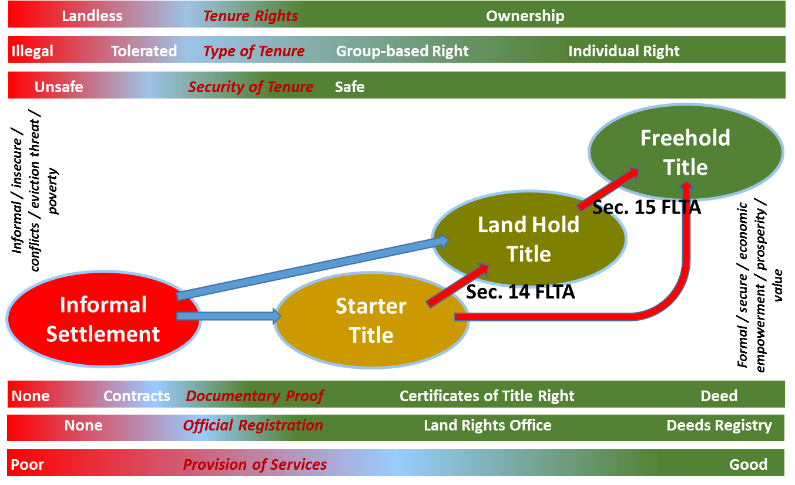
Upgrade of Schemes

Slide 10
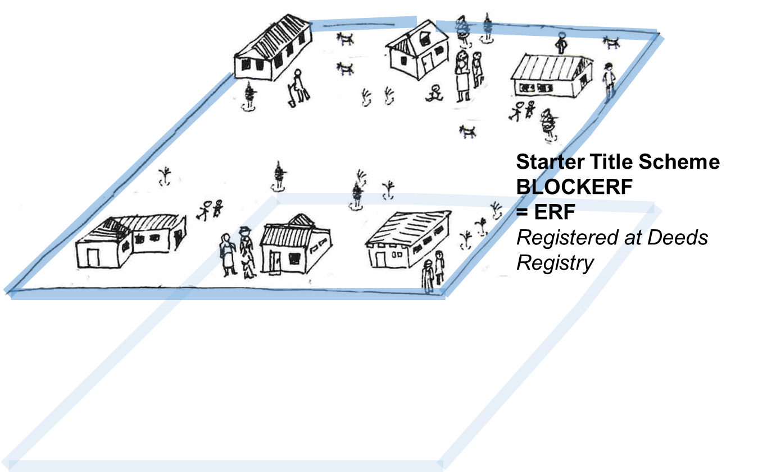
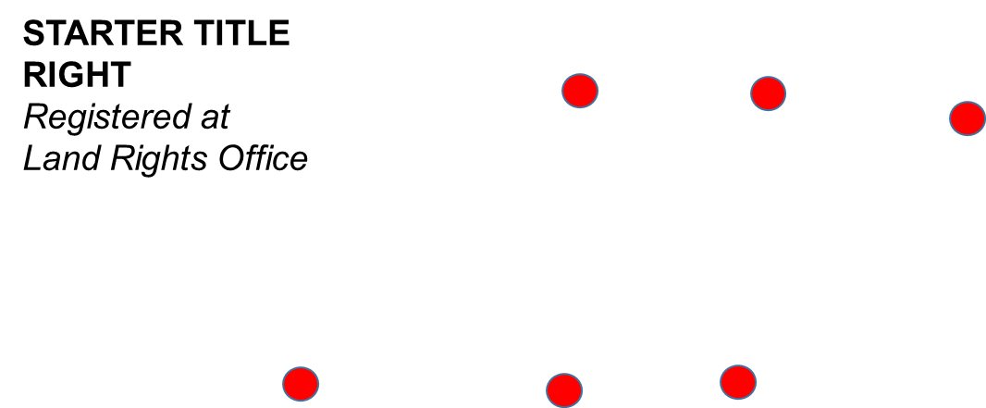

Exemplary of a Starter Title Right
Starter Title rights: Gives a holder rights over a dwelling at a specified location within the Blockerf
Land Rights cannot be used as a security for credit

Slide 11
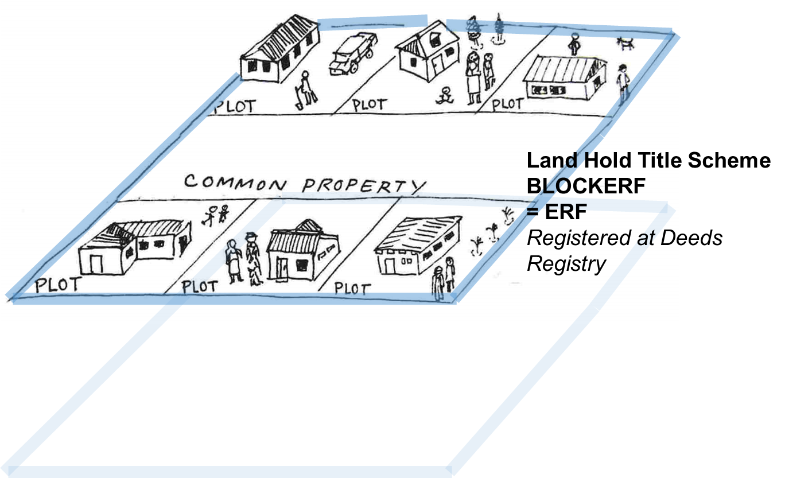

Exemplary of a Land Hold Title Right
Land Hold Title Rights: Gives the holder the same rights over the piece of land within the blockerf as the owner of freehold
Land rights held under a land hold title can be used as a security for credit.

Slide 12
Conclusion
This pilot phase is the first experience in Namibia
FLTS is only targeting people living in the informal settlement
The titles under FLTS are legal and supported by law
The titles are been registered in a legal registration system (Land Rights Office)
Titles are transferred, inherited and can be used a security for loans (Land Hold Titles)

Slide 13

I thank you for your attention

